Slide 1
Tech Titans
Team Members
Rahul Singh 2210990704
Poorva 2210990656
Piyush Kapoor 2210990651
Prabal Rai 2210990657

Slide 2

E-Commerce Merchandise - SNAPKART
An e-commerce platform built with MySQL, Sequelize, React, Express, and GitHub.

Slide 3

Overview & Importance
This scalable platform allows businesses to establish a customizable storefront. It enhances sales and improves customer experience.
E-commerce is projected to reach $6.4 trillion in sales worldwide in 2024. This platform addresses that growing demand.
1
Enhanced sales
2
Streamlined operations
Reach a wider customer base.
Automate key processes.
3
Improved experience
Offer a user-friendly interface.

Slide 4
Tech Stack: Powering the Platform
The platform uses ReactJS on the frontend and Node.js with Express on the backend. MySQL and Sequelize provide reliable data storage.
Frontend: ReactJS
Backend: Node.js, Express
Database: MySQL, Sequelize
Component-based UI with Redux for state management. Libraries like Material-UI ensure a consistent design.
JavaScript runtime for server-side logic. Express helps build robust APIs and handles HTTP requests. JWT provides secure authentication.
Relational database for structured data storage. Sequelize simplifies interactions and ensures data consistency.

Slide 5
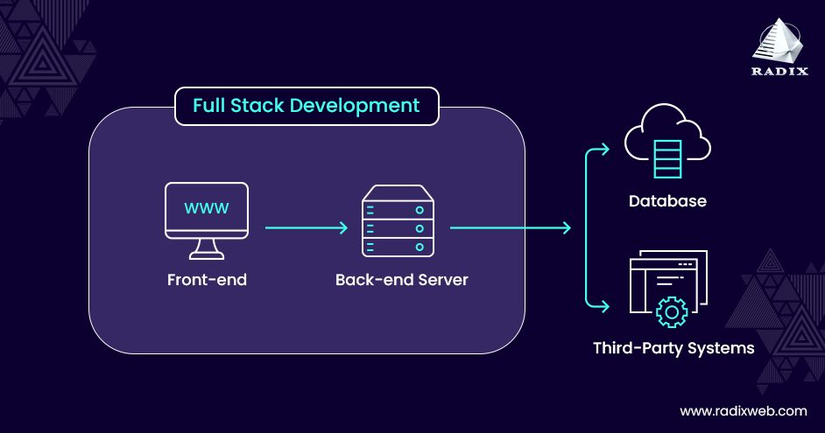



System Architecture
The frontend interacts with the backend API. The backend processes data and interacts with the database.
Data flows between components: user action -> frontend -> backend -> database -> backend -> frontend.
Frontend
ReactJS User Interface
Backend
Node.js, Express API
Database
MySQL, Sequelize

Slide 6
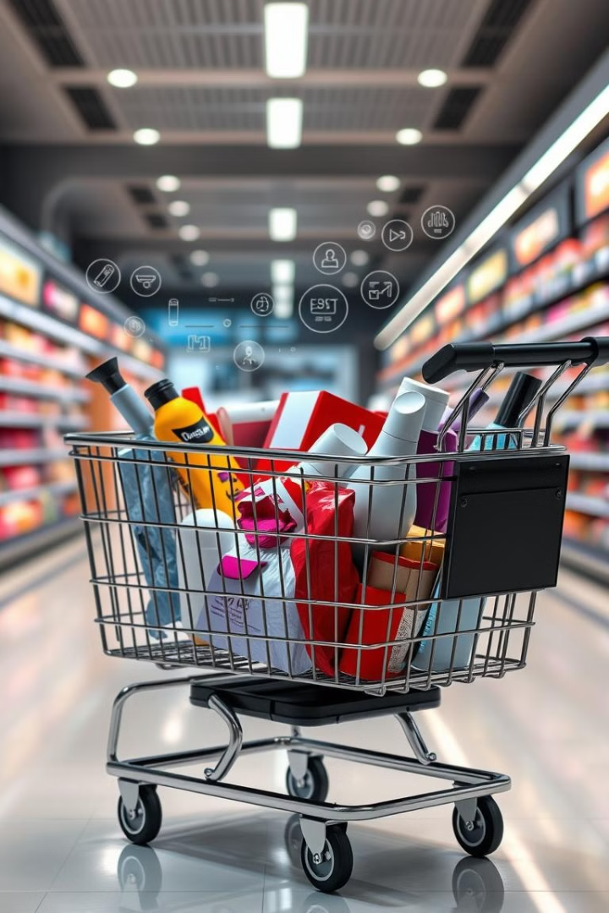
Key Features: Core Functionality
The platform offers secure authentication and product listing. Customers can place orders and make payments easily.
Authentication
Secure user registration and role-based access control.
Product Listing
Browse, search, and view product details easily.
Orders
Shopping cart and order tracking.
Payments
Secure payment gateway integration.

Slide 7
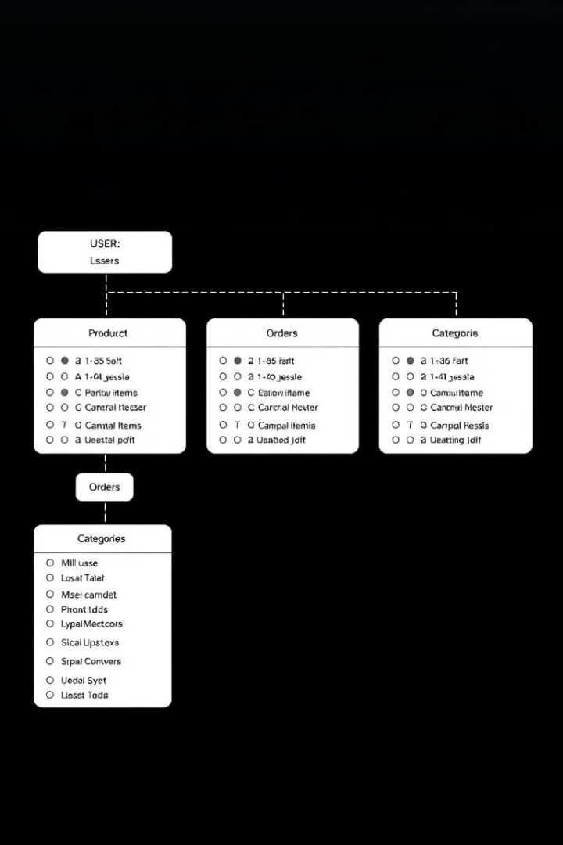
Database Design: Key Tables & Relationships
Key tables include users, products, orders, and order items. One user can have multiple orders
1
Users
User information like ID, username, email.
2
Products
Product details like name, description, price.
3
Orders
Order information including user and total amount.

Slide 8





Implementation: Development Process
Agile development with sprint cycles ensures iterative progress. Continuous integration and testing with Jest maintains code quality.
The platform is deployed on AWS with CI/CD pipelines.
Jira
Jest
AWS
For task tracking and workflow
For testing
Hosting provider

Slide 9




Future Enhancements
Planned enhancements include faceted search and social media integration. We will also develop mobile apps and AI-powered recommendations.
Enhanced search
1
Social media
2
4
AI
3
Mobile app

Slide 10
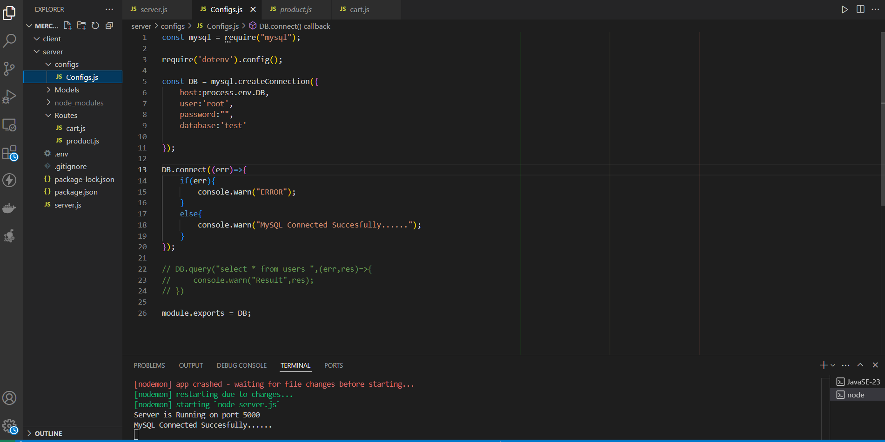
Screenshot

Slide 11
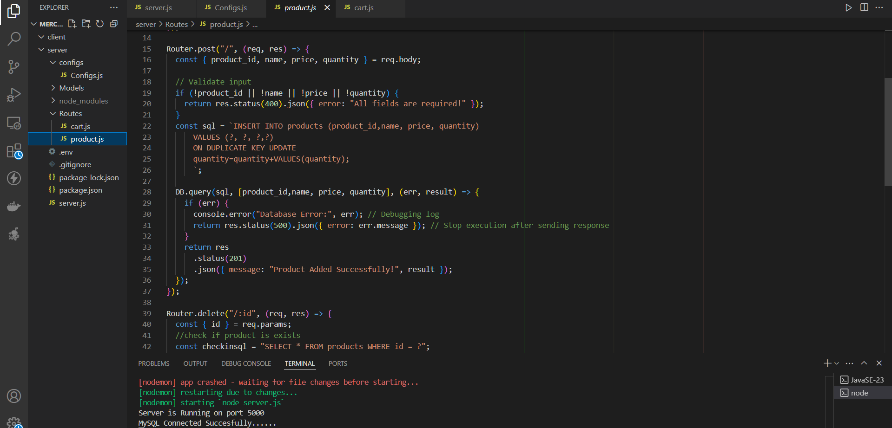

Slide 12
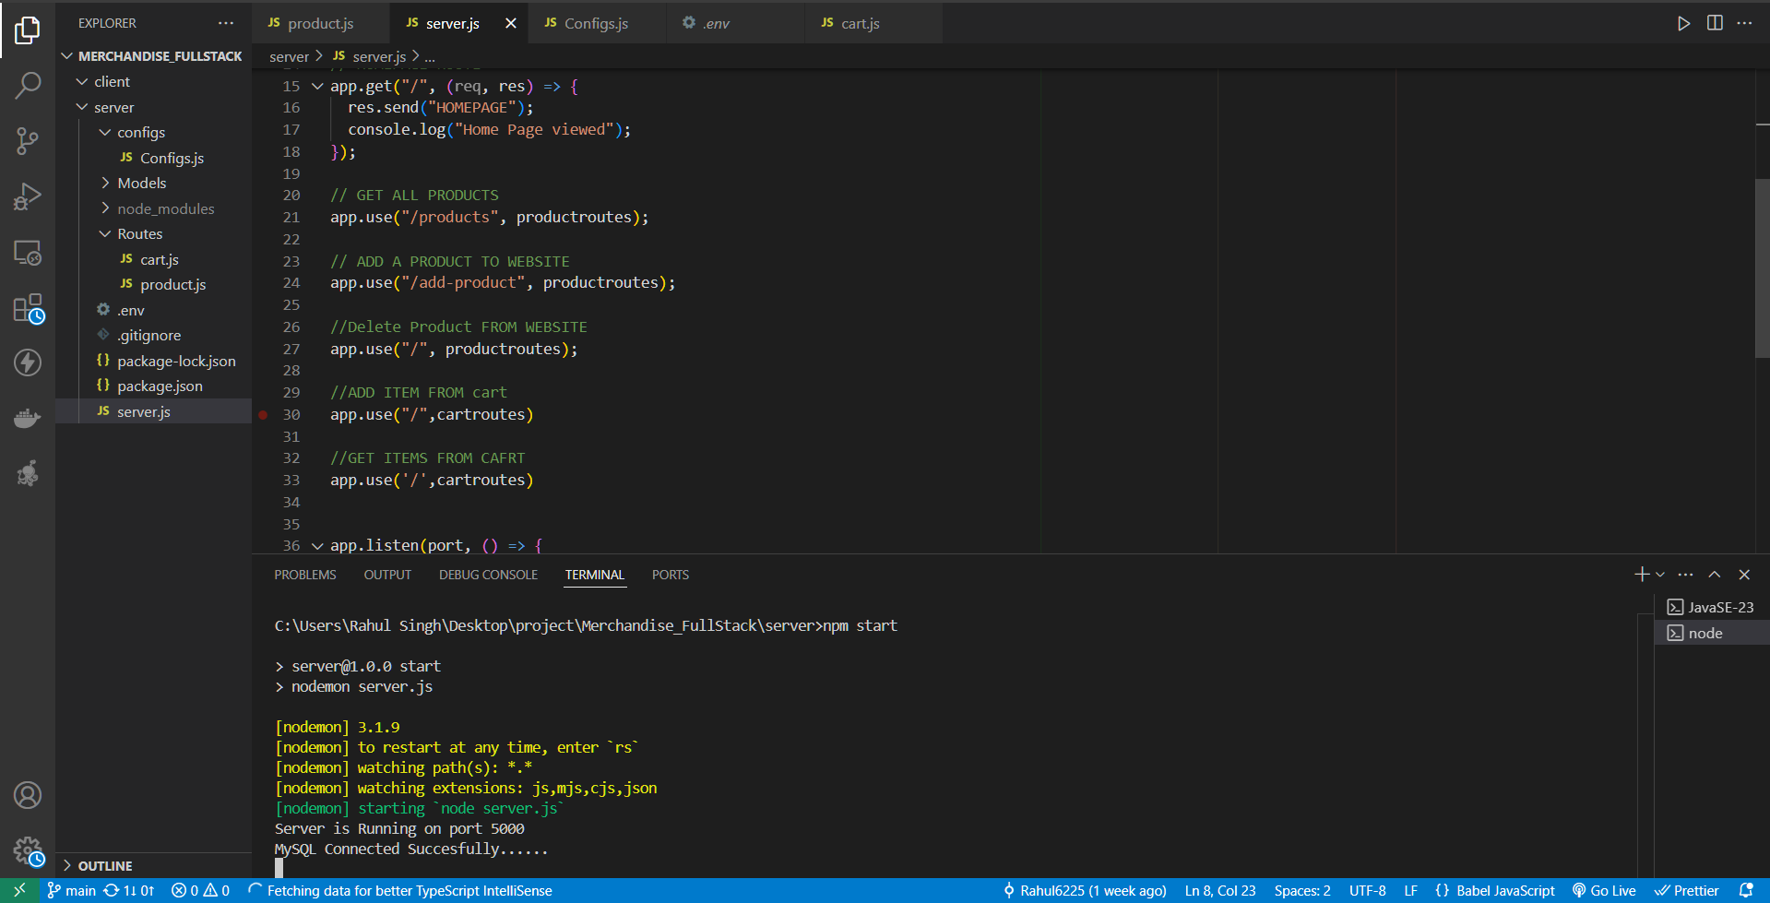

Slide 13
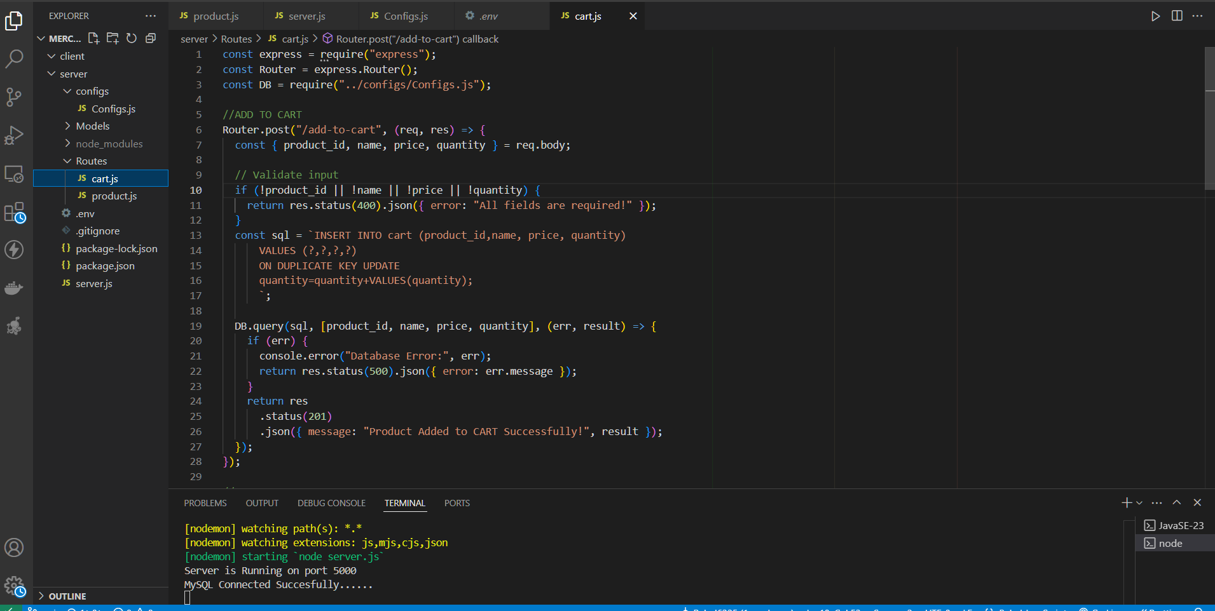

Slide 14
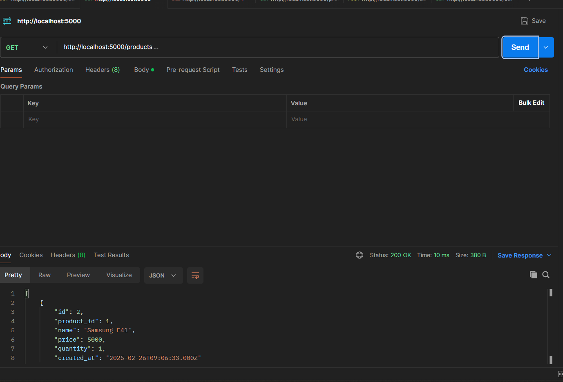

Slide 15
